Slide 1
HW6 Report

Slide 2
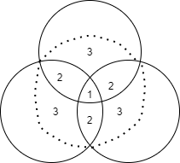
COCO subset
Given the instructions, I construct the COCO subset in three steps.
First, obtain the subset with all three classes appear. That is the intersection of all three classes.
Second, obtain the subset with each two classes appear. That is the intersections of each two classes.
Third, obtain the subset with each class having at least 2 objects appear. That is the subset of each class.
Finally, combine three subsets and eliminate the duplicates, filter the combine subset by limiting maximum 5 objects appear.

Slide 3
COCO subset: download
All selected images and their corresponding path are packed into a list, later use COCO API to download them into Training folder. Then open each image and convert it to RGB and 128*128 size.
The dataloader creates an image tensor from the image; a [5,4] bbox tensor with 5 objects and 4 values (x,y,w,h); a [1,5] bbox label tensor with string label converted to integer; number of objects in image.
A subset of size 10000 is downloaded for training and 1000 for testing. In running the model, due to hardware limitations, the model is trained on only 1000 images for 20 epochs, and testing on 300 images.
Classes “Person”, “Chair”, “Car” are selected.

Slide 4
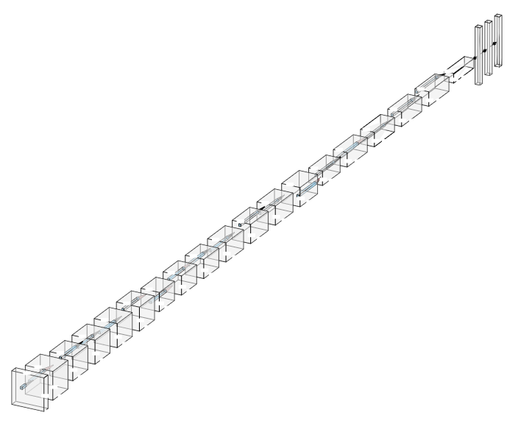
Network Design
The Network has 19 convolutional layers followed by two fully connected layers. The image size is (128, 128).

Slide 5
Network Design (cont.)
The network takes in 128*128 image [3, 128, 128].
Two pre-process applies two convolutional layers, relu activation functions, and maxpool layers. The input is converted to [64, 32, 32].
Through 3 groups of convolutional layers together with SkipBlock applied, the output is [256, 4, 4].
Before feed into the fully connected layers, the output is converted to [1, 4096].
After two fully connected layers, the output is a [1, 1440] vector.

Slide 6
Network Design: YOLO-like Detector
For each 128*128 image, use yolo_interval of 20 to obtain a 6*6 cell grid.
For each cell, there are 5 candidate anchor boxes with different aspect ratio (h/w): 1/1, 1/3, 1/5, 3/1, 5/1.
The idea is letting the anchor box whose center is closest to object bounding box be the responsible box.
I only considered images with maximum of 5 objects detected.
A yolo vector is constructed for each anchor box. Each vector is of size [1, 8], with the index 0 means the confidence the anchor box contains the object (I used the IoU for index 0 in case some object bounding box is smaller than the candidate anchor box), index 1 and 2 means the offsets of coordinates, index 3 and 4 correspond the bounding box height and width, and the last three indexes correspond the class labels.
[IoU, delx, dely, bh, bw, c1, c2, c3]

Slide 7
Network Design: YOLO-like Detector (cont.)
If the bounding box label is one of the three selected classes, corresponding index in the yolo vector is set to 1. For unselected classes, in my case, bounding box label tensor with value 13, the corresponding index in the yolo vector is 0.
Therefore, for all cells, each cell has 5 anchor boxes, an image will turn into a [36, 5, 8] vector, which correspond my network output dimension [1, 1440].

Slide 8
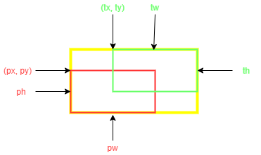
Network Design: YOLO-like Detector (cont.)
I have implemented the Yolo Loss function based on the equation in Yolov1 paper, but the training result is not optimal. Therefore, I choose MSE instead. The Yolo Loss function can be found in model.py file with class name YoloLoss.
A customized IoU metric is implemented for testing. The idea is given the true bounding box and predicted bounding box coordinates and width and height, the two diagonal coordinates can be calculated. Within the larger region covered by the diagonal coordinates, go through each pixel and check if the pixel is within the bounding boxes. If it is in both boxes, count as intersection and union; if only one box, count as union; otherwise do not count. The IoU error is calculated by intersection / union.

Slide 9
Network Design: YOLO-like Detector (cont.)
To obtain the predicted bounding boxes coordinates, I unscrambled the output of the network.
From the output, bh and bw can be used to obtain the pred_h and pred_w of the predicted bounding boxes. Since the true bounding box x, y, w, h are given, the pred_x, pred_y can be calculated from x, y, pred_h, pred_w and the predicted offsets of center coordinates.
Since the false alarm predictions are important, I unscrambled the output and obtain the all the predicted label for each responsible anchor box. By constructing a confusion matrix between the true_labels and pred_labels, I can identify the false alarms by counting the number 13 in pred_labels.

Slide 10
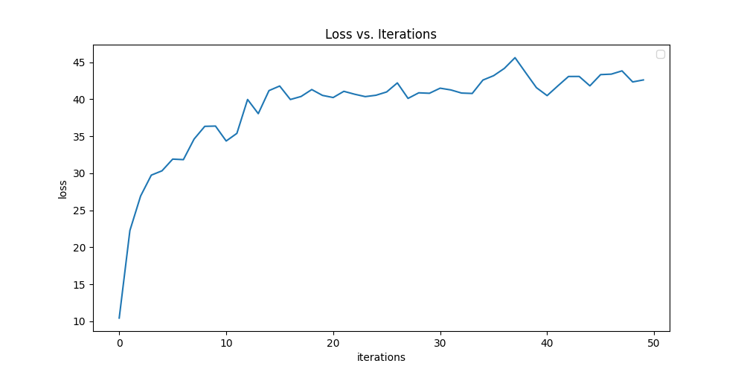
Results
Since the training dataset is small, the model underfits the data.

Slide 11
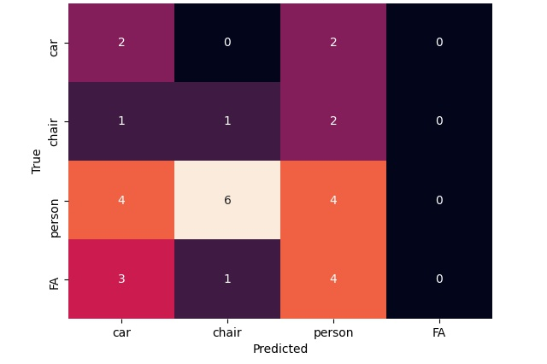
Results
The confusion matrix is generated on every 50 images of 300 images, FA meaning the false alarm class.

Slide 12
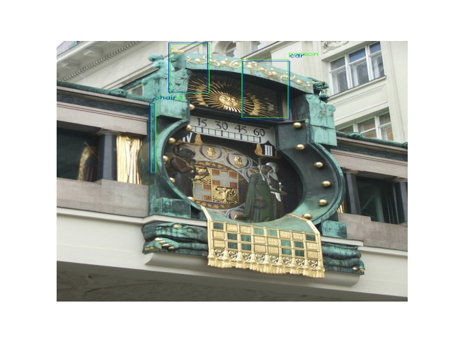
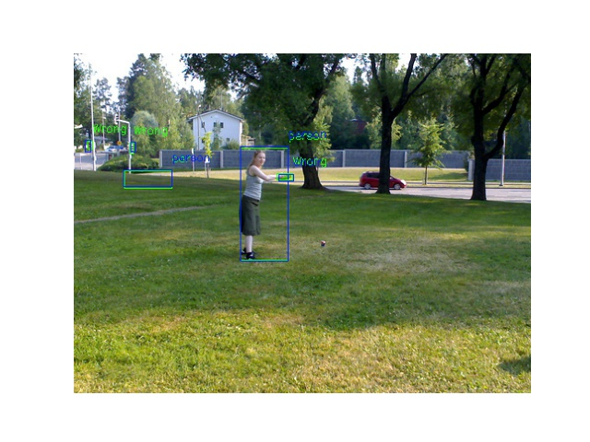
Results
Sample predicted bounding box. Blue indicates prediction, green indicates truth. (Wrong label indicate unselected class)

